Slide 1
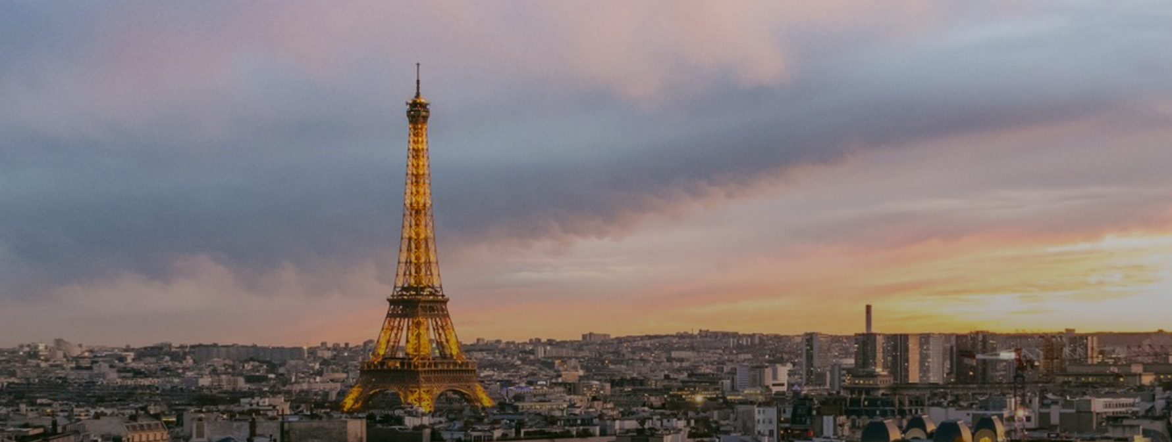
Unit 7
The Eiffel Tower

Slide 2
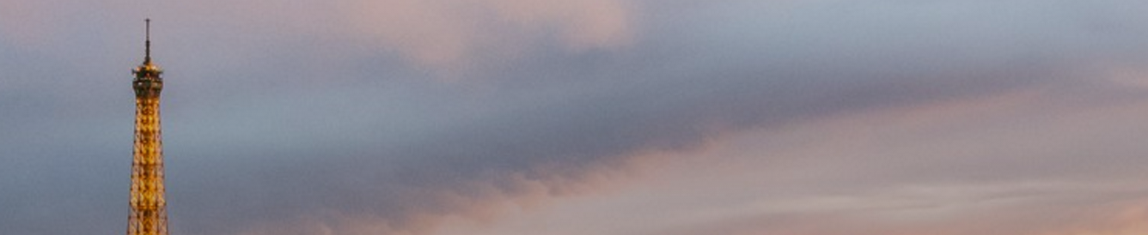
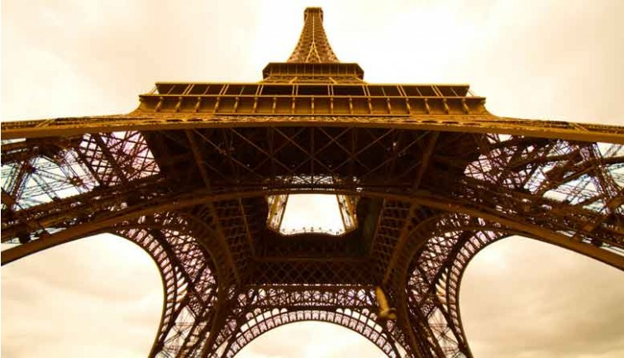
Warm-up

Slide 3
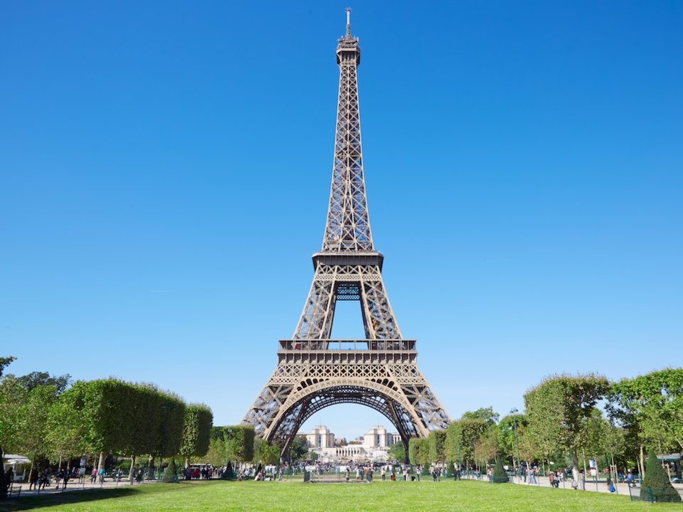
Warm-up

Slide 4
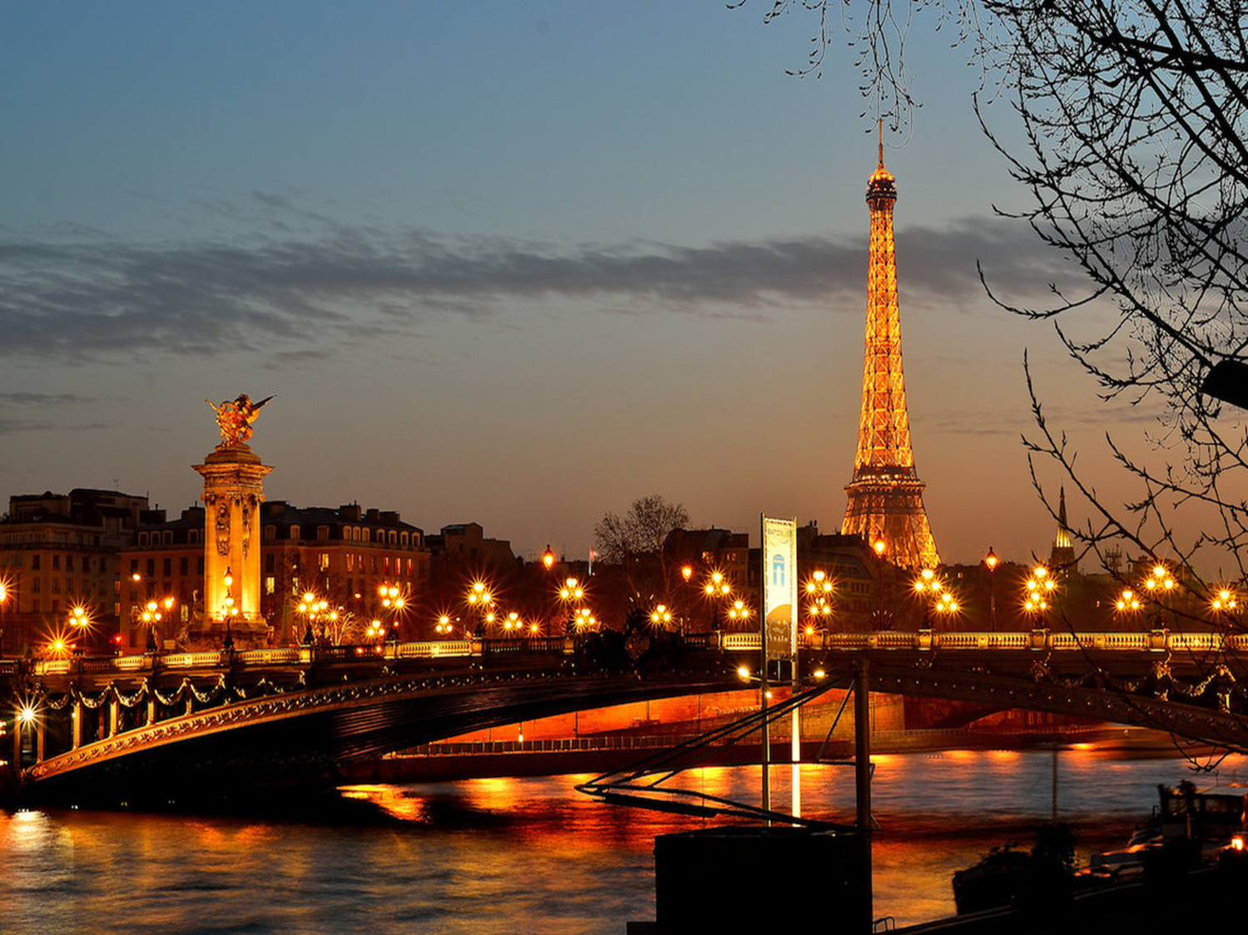
Warm-up

Slide 5
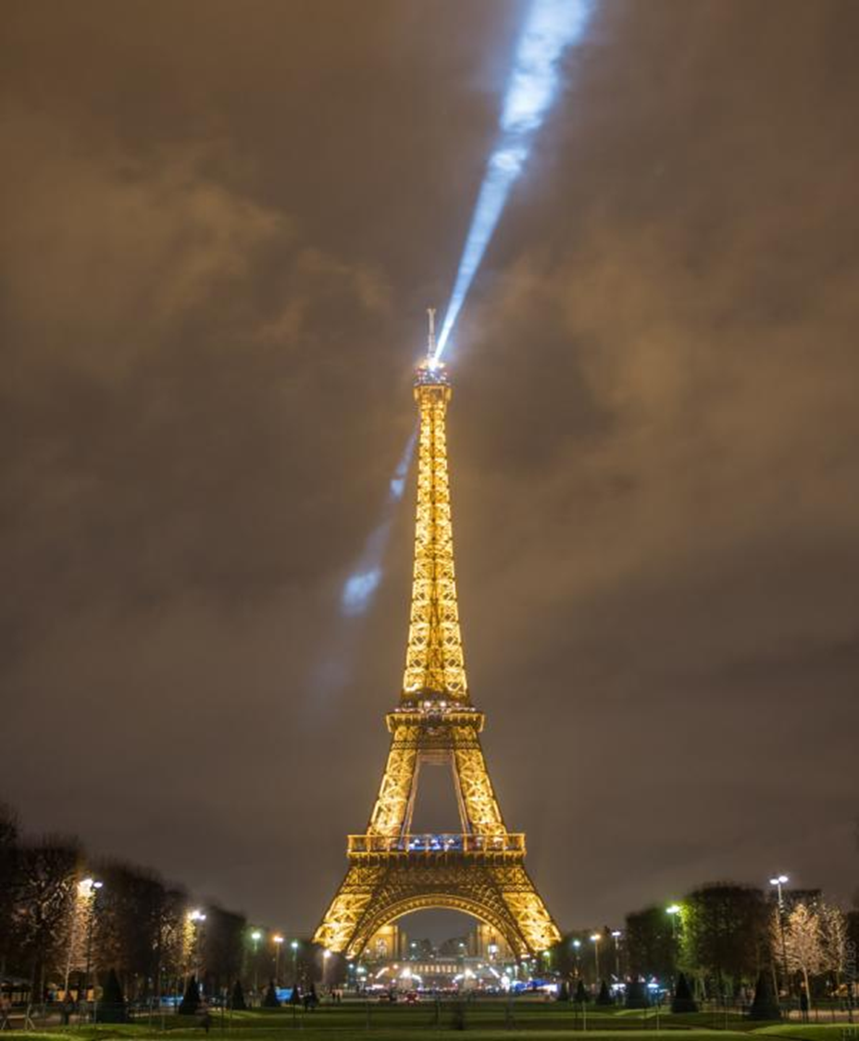
Warm-up

Slide 6
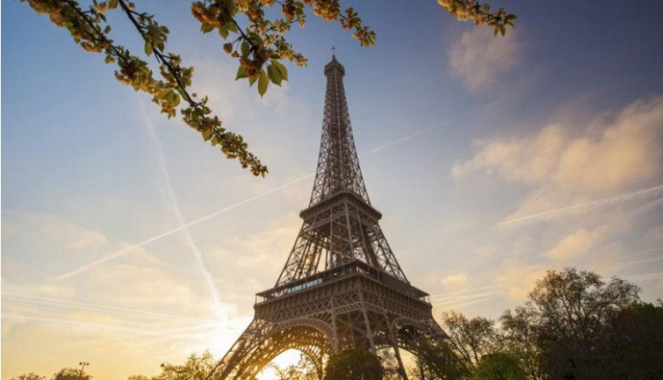
Warm-up

Slide 7
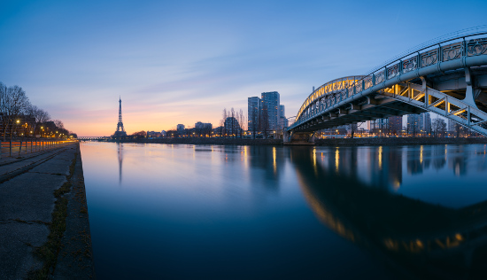
Warm-up

Slide 8
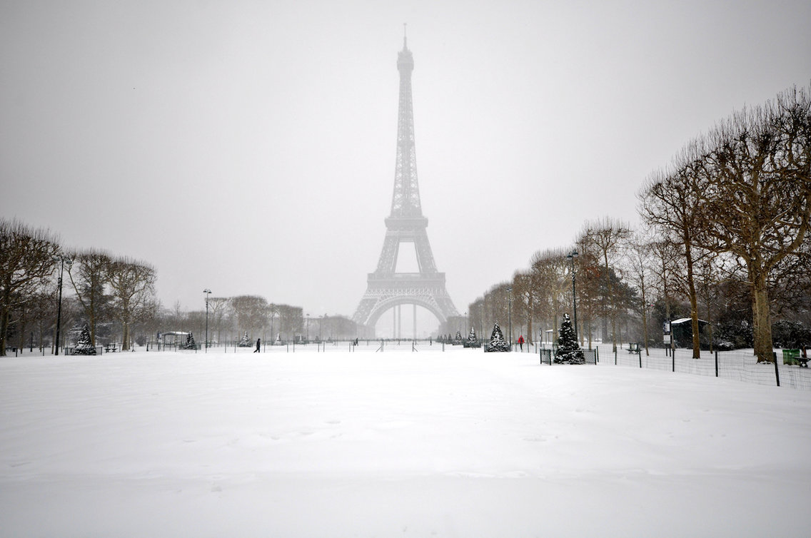
Warm-up

Slide 9
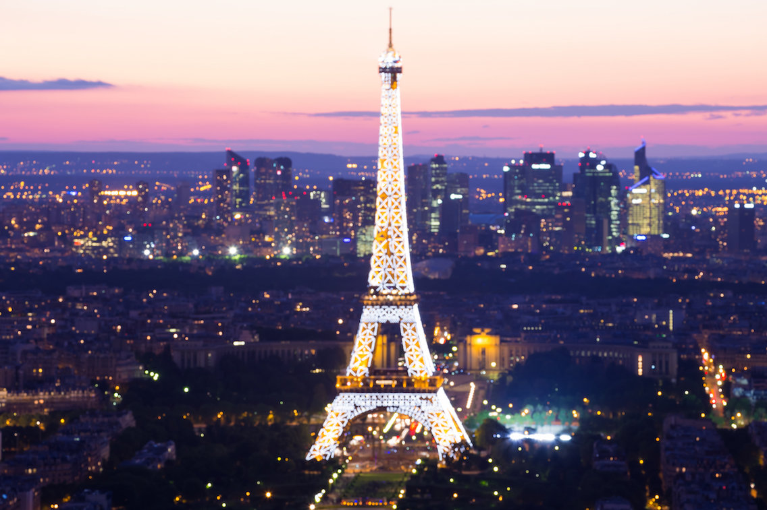
Warm-up
Seine river at night

Slide 10
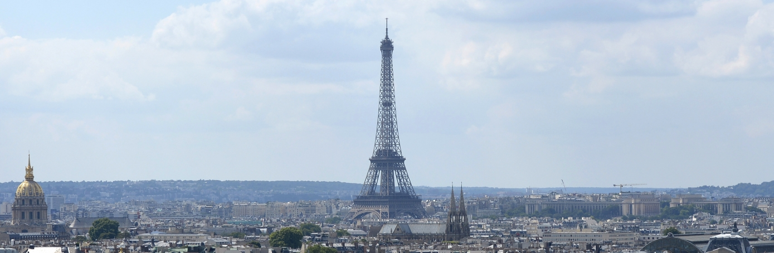
Cultural Notes

Slide 11
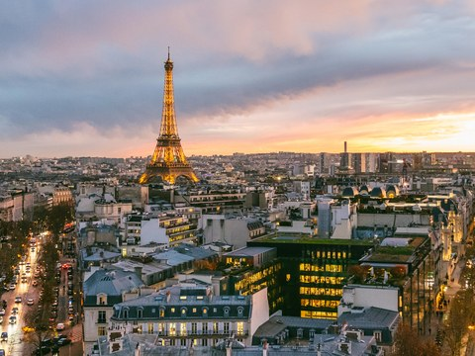
Cultural Notes

Slide 12
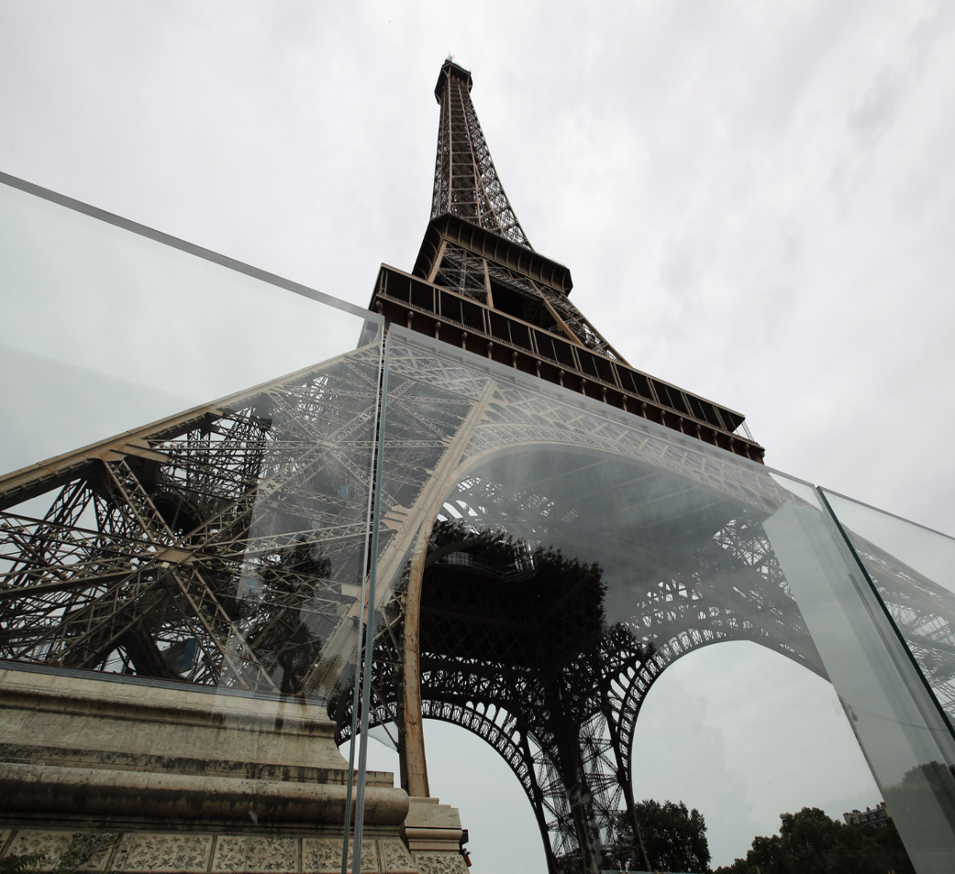
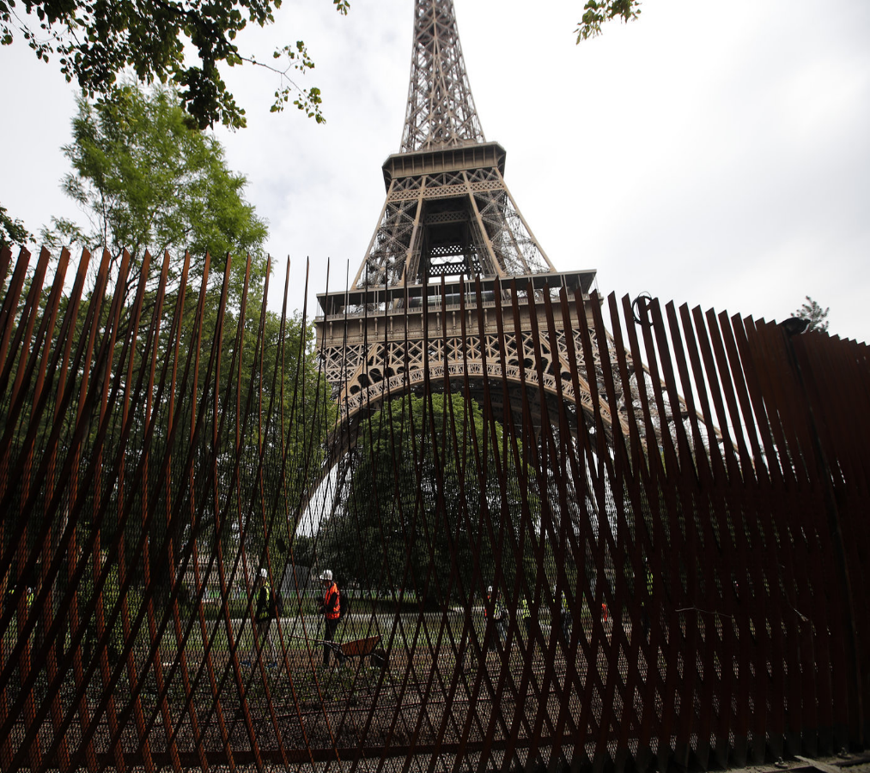
Cultural Notes
New metal fencing by the Eiffel Tower is meant to dissuade vehicles from ramming into the tourist site.
Newly installed panels of bulletproof glass surround two sides of the Eiffel Tower site in Paris. Construction is scheduled to be complete in July.

Slide 13
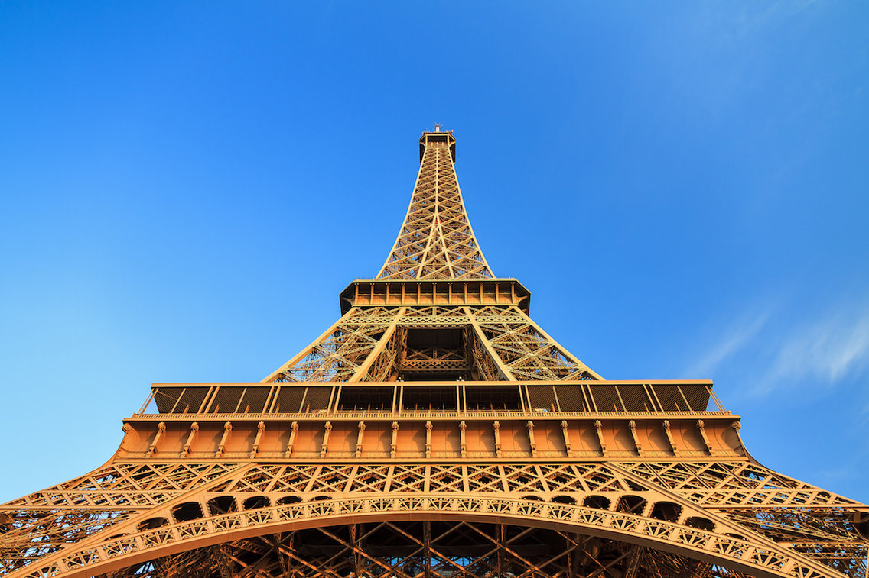
Cultural Notes

Slide 14
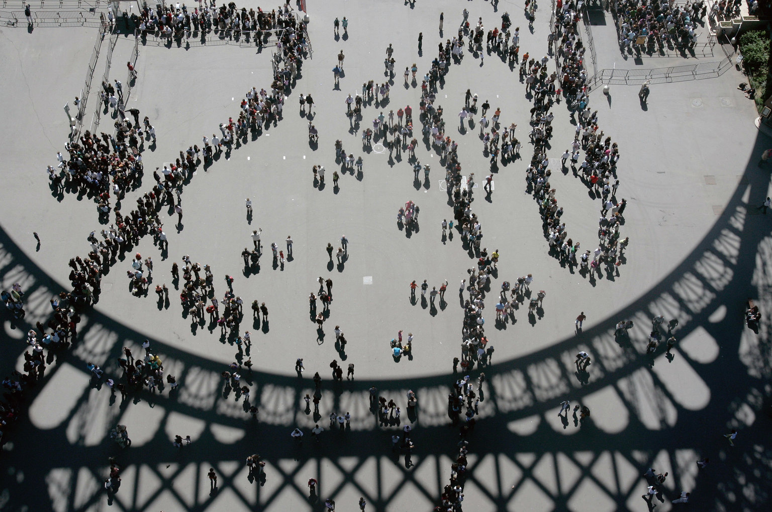

Slide 15
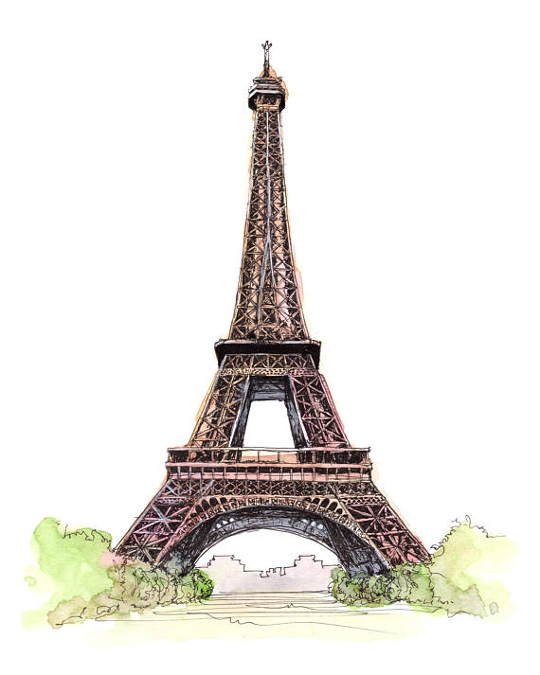
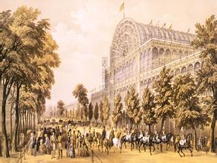
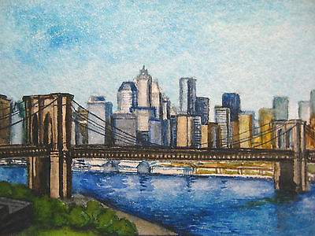
Text Organization
The Crystal Palace
The Brooklyn Bridge
The Eiffel Tower

Slide 16
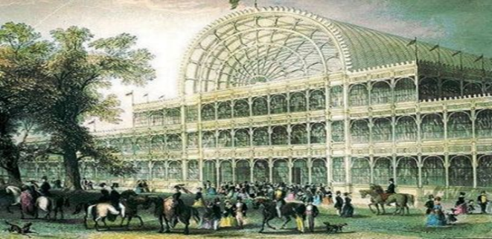
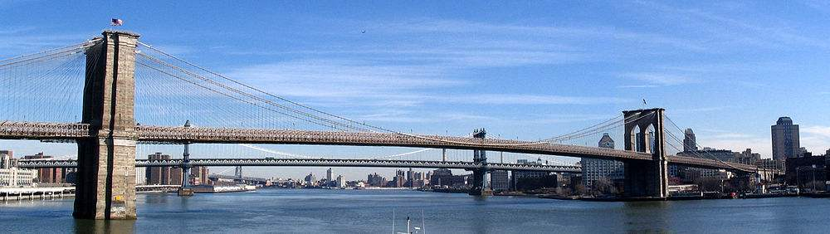
Text Organization
Structures
with utilitarian
purposes
The Crystal Palace
The Brooklyn Bridge
for the
Great
Exhibition
1851
for
other exhibitions
&concerts
to connect
two boroughs
of NYC
to
increase
real estate
value
The Eiffel Tower
Despite the architect’s extolment, it is not utilitarian (useless).

Slide 17
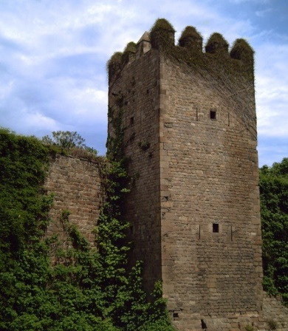
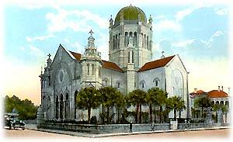
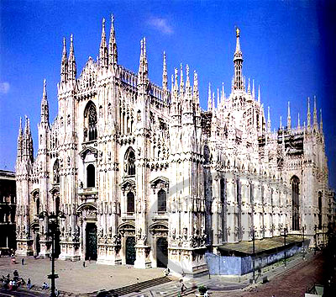
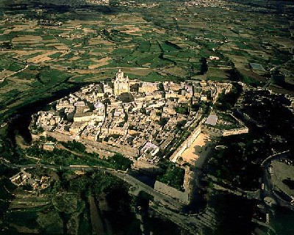
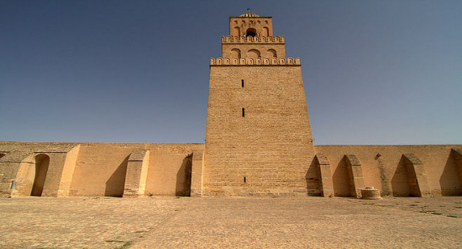
Text Organization
symbols of civic pride
Defense
Tower
Structures for spiritual
purposes
Renaissance church
Gothic cathedral
medieval walled town
The Eiffel Tower
The Eiffel Tower is not spiritual (not lofty).
minaret

Slide 18
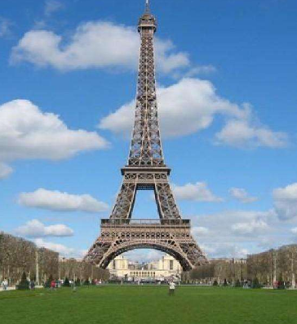
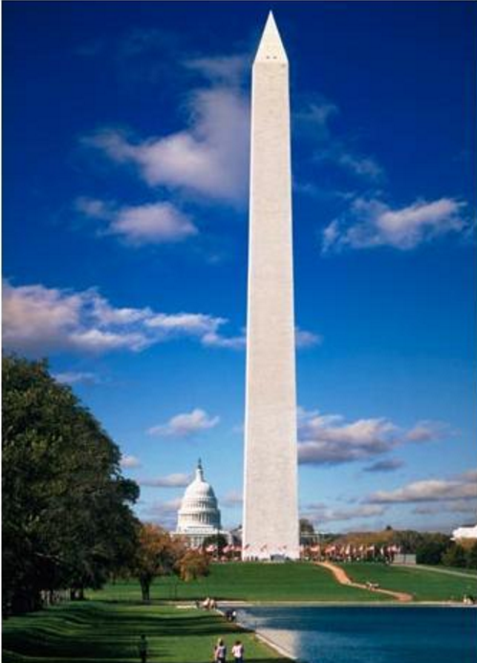
Text Organization
Paragraph 1
a magnificent view of Paris
a military lookout
the salubrity of the air
a laboratory to experiment with wind and gravity
a leader of the technical world

Slide 19
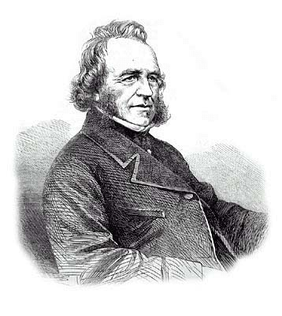
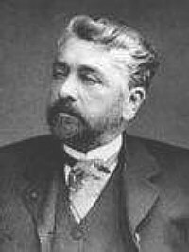
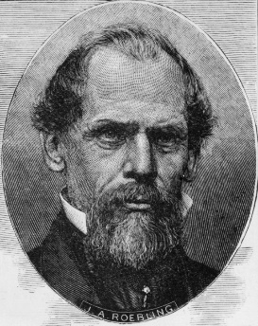
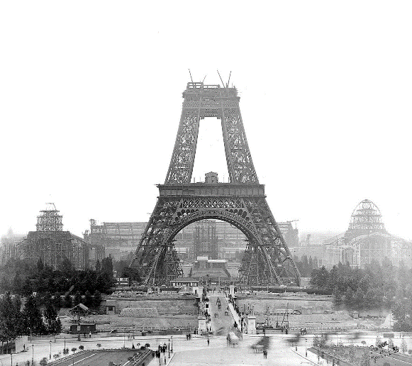
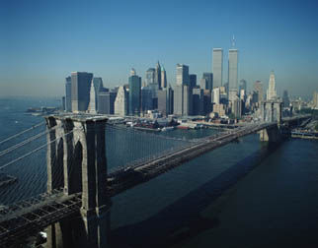
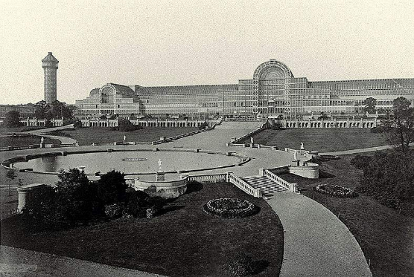
Text Organization
Read para. 1 again and match the architects with their works.
Sir Joseph Paxton
Gustave Eiffel
John A. Roebling
The Eiffel Tower
under construction
Brooklyn Bridge
The Crystal Palace

Slide 20
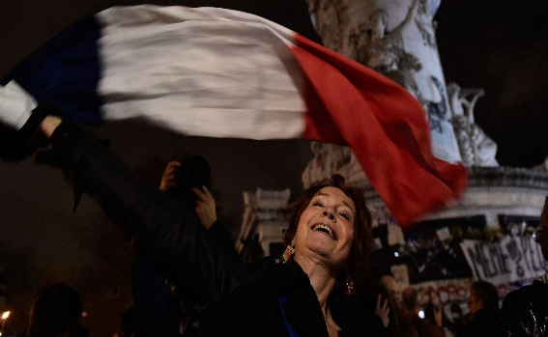
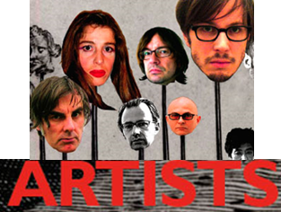
Text Organization
Parisians
admire
get hell
a resounding letter
Maupassant’s never relenting attitude
The Eiffel Tower

Slide 21
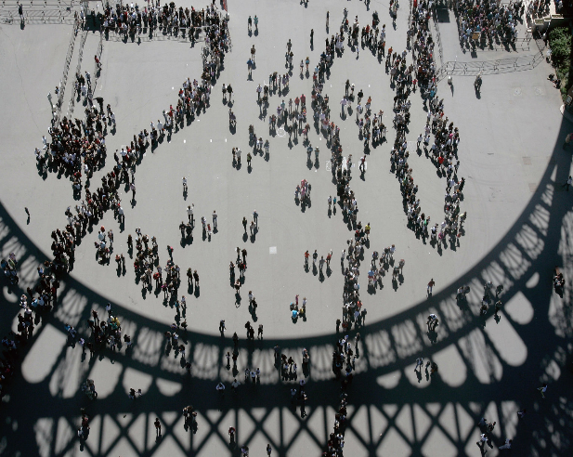
Text Organization
the symbol of Paris
the symbol of France
Parisians
exalt
visits
from human structure to human symbol
love at first sight
Attempts to destroy it, but in vain
Hitler
Algerian rebels
The Eiffel Tower
French right-wing
military opponents

Slide 22
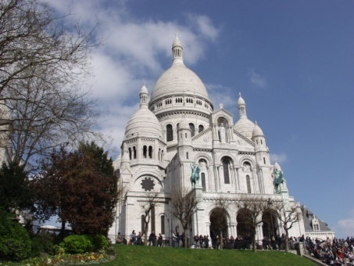
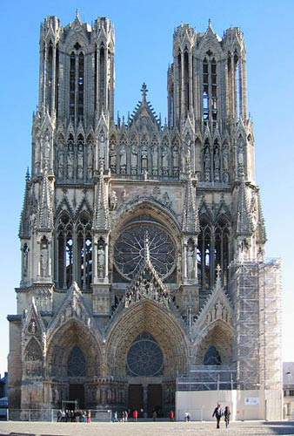
Paragraph 4
Text Organization
Scan paragraph 4 for NÔtre Dame and Sacré Coeur. Work in pairs. Match the accounts with the pictures.
NÔtre Dame: one of the most
famous cathedrals in Paris, France.
It is built in the Gothic style
Sacré Coeur: a famous church in
Paris built on a hill during the late
1800s and early 1900s.

Slide 23
Paragraph 4
Text Organization
Work in pairs and complete the paragraph about NÔtre Dame with the correct form of the words in Activity 4, P138.
The cathedral of NÔtre Dame in Paris is one of the city’s most beautiful Gothic monuments. The site of the cathedral is quite old, and in fact, some archaeologists believe that NÔtre Dame was built on the site of earlier churches and (1) ____________ buildings. Maurice de Sully, Bishop of Paris, decided to build the NÔtre Dame cathedral because the city’s population was growing.
medieval

Slide 24
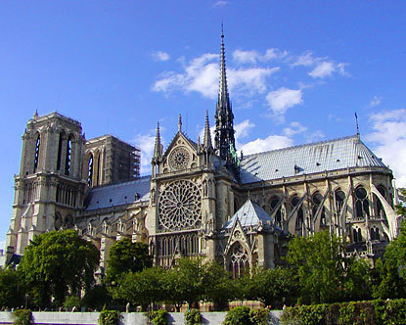
Paragraph 4
Text Organization
It was the first truly (2) ___________ cathedral to be built in France, large enough to both meet the city’s religious needs and to inspire (3) _________ pride in the beauty of its monuments.
gigantic
civic

Slide 25
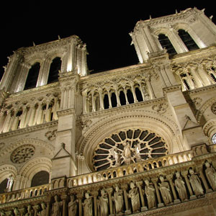
Paragraph 4
Text Organization
The cathedral took nearly 200 years to build, and is therefore a blend of different architectural styles. The cathedral is 48 metres wide and its two towers are 69 metres high. Visitors who climb to the top have a wonderful view out over the city of Paris.

Slide 26
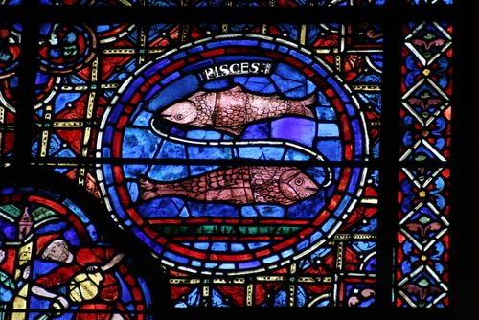
Paragraph 4
Text Organization
Nôtre Dame is particularly famous for its elaborate
windows made from colourful stained glass that shines like (4)________ in
the sunlight, and the intricate stone carvings that decorate the outside of the cathedral.
crystal
stained glass windows
in NÔtre Dame Cathedral

Slide 27
Paragraph 4
Text Organization
It is established that France alone had the (5) ________ of erecting such buildings so many years before the modern age. The skill and experience
acquired in building Nôtre Dame was (6) __________ to architects designing other cathedrals within and beyond the borders of the French nation.
capability
transferred

Slide 28
Protests
Text Organization
Read Paragraph 3. Work in pairs and match the protesters with their identities.
Bouguereau
Garnier
Dumas,Jr.
Gounod
Leconte de Lisle
Prudhomme
Guy de Maupassant
the novelist
the composer
the architect of Opéra
the academic painter
the poet
the essayist

Slide 29
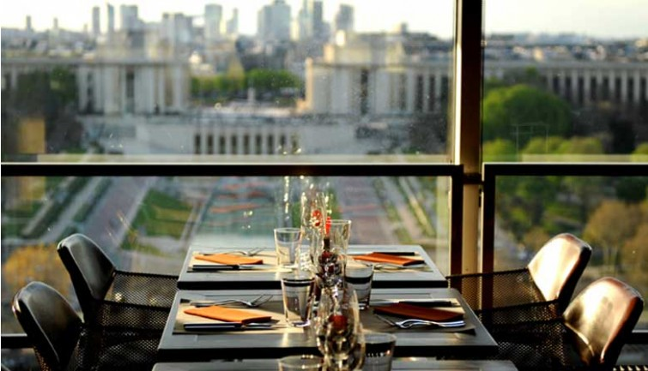
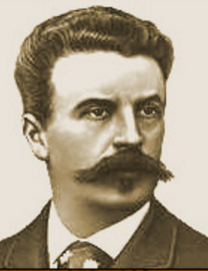
Text Organization
Protests

Slide 30
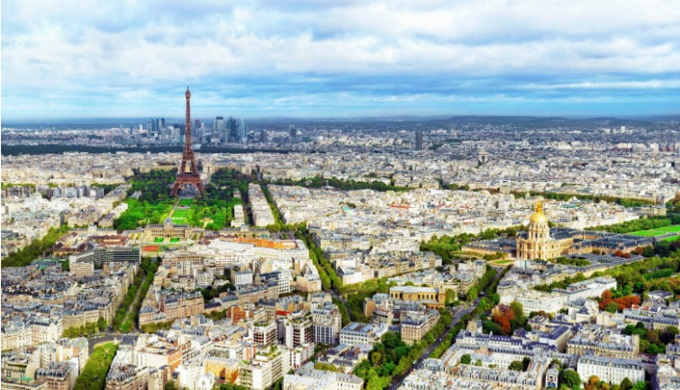
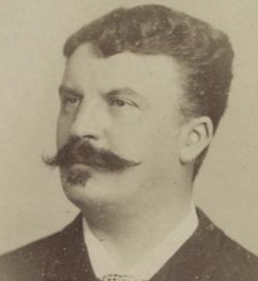
Text Organization
Protests

Slide 31
Summarising
Text Organization
Work in pairs and summarise the text by filling in the blanks.
Some structures are built for _______________ purposes. The ____________ Palace had been used for several purposes till it was burnt down in 1936 and the Brooklyn Bridge was not only very practical to link two great _______________, but also of great commercial value.
utilitarian
Crystal
boroughs

Slide 32
Summarising
Text Organization
Some structures are built for _______________ purposes. The defense towers and all the other great towers of the past were built as symbols of _____________ pride.
However, the Eiffel Tower _________________ nothing so lofty or utilitarian. It was subject to _______________ protests from noted artists, but common people loved it.
spiritual
civic
acknowledges
indignant

Slide 33
Summarising
Text Organization
Slowly but surely, the visits to it _____________ new meanings. It became the symbol of Paris and the Mecca of all travellers, and then the symbol of France. As a __________ monument, Hitler, the Algerian rebels and the French right-wing military ____________ attempted to destroy it but all of them tried in vain. It is still the Tower of Towers and become a great human symbol.
acquired
symbolic
opponents

Slide 34
Difficult sentences
Difficult sentences
1. Sir Joseph Paxton’s Crystal Palace not only … a lost symbol of happiness and brotherhood. (Para 1)
2. Monsieur Eiffel extolled its utility … almost 1,000 feet. (Para 1)
3. They went to look at the Tower as much as… the other monuments of their city. (Para 4)
4. Surpassed in height … it is still the Tower of Towers. (Para 4)
click
click
click
click

Slide 35
Difficult sentences
Difficult sentences
1. Sir Joseph Paxton’s Crystal Palace not only served royally the Great Exhibition but, being demountable, was transferred afterwards to Sydenham, where it was used for sculpture, painting and architectural exhibits, and for concerts until November 1936, when it burned, a lost symbol of happiness and brotherhood. (Para 1)
Answer the questions and translate the sentence.

Slide 36
Difficult sentences
(a) What was transferred to Sydenham?
(b) Why was it possible for it to be transferred?
(c) What was the Palace used for in Sydenham?
(d) What burned?
(a) The Crystal Palace.
(b) It was demountable.
(c) It was used for sculpture, painting and architectural exhibits and for concerts.
(d) The Crystal Palace.
约瑟夫· 帕克斯顿爵士设计的水晶宫不仅为世博会上大展用
途，而且因为可拆卸，水晶宫在世博会之后被移到西德纳姆镇，
用来举办雕塑、绘画和建筑展览以及音乐会。1936年11月水晶
宫毁于一场大火，它是一个失落了的代表幸福和博爱的象征物。

Slide 37
Difficult sentences
Difficult sentences
2. Monsieur Eiffel extolled its utility as a military lookout, the salubrity of the air at its top, its uses as a laboratory to experiment with wind and gravity, but the innerspring to its construction was to demonstrate that France,100 years after the revolution, was a leader of the technical world, capable of realizing the dream of a tower 300 meters high, almost 1,000 feet. (Para 1)
Answer the questions and translate the sentence.

Slide 38
Difficult sentences
Difficult sentences
(a) What uses did Monsieur Eiffel praise the Tower for?
(b) What was his main motivation in constructing the Tower?
(c) What did he say France was capable of doing?
(a) He extolled its utility as a military lookout, the salubrity of the air at its top and its uses as a laboratory to experiment with wind and gravity.
(b) To demonstrate that France was a leader of the technical world.
(c) Realising the dream of a tower 300 meters high.
埃菲尔先生极力赞美此塔的功用，认为它可
用作军事瞭望塔，在塔顶呼吸新鲜空气有益
于健康，在塔上还可以进行风和重力方面的
实验。但建造埃菲尔铁塔的真正内在动机是
要向世界表明，在法国大革命100年之后，
法国的科技已处于世界领先地位，能够实现
建造300米（差不多有1,000英尺）高塔的梦想。

Slide 39
Difficult sentences
3. They went to look at the Tower … the other monuments of their city. (Para 4)
Work in pairs and answer the questions.
(a) What reasons did people have for visiting the Tower?
(b) What could they look at inside the Tower?
(c) How could they point to other monuments in Paris?
(a) To look at and from the Tower.
(b) Its steel framework.
(c) By ascending it and getting a view of the city.
参观者不仅是去看埃菲尔铁塔，也是要从塔上俯瞰整个巴黎。
人们不仅要看它的内部结构，看它的钢架工艺，也要在塔
上指出他们城市的其他名胜古迹。

Slide 40
Difficult sentences
Difficult sentences
4. Surpassed in height by many a modern utilitarian tower, by chimneys, antennas and skyscrapers, it is still the Tower of Towers. (Para 4)
Translate the sentence.
现在许多有实用价值的高塔、烟囱、天线和摩天大楼都超过了埃菲尔铁塔的高度，但它依然是塔中之王。

Slide 41
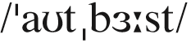
Words & Phrases
Words & Phrases
outburst n. [C]
1. a sudden temporary increase in activity 激增
e.g.
The years before the First World War witnessed a remarkable outburst of poetic creativity.
第一次世界大战前的年月里，诗歌创作有显著发展。
2. the sudden start of an activity or emotional reaction among a lot of people （活动或情绪在一大群人中的）突发
e.g.
A player was cautioned for his angry outburst against the referee.
一名运动员因对裁判发怒而受到警告。

Slide 42
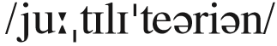
Words & Phrases
utilitarian a. designed to be useful rather than attractive 实用的；功利的
e.g.
The buildings were utilitarian rather than decorative.
这些建筑是实用性的，而不是装饰性的。
The utilitarian philosophy of Jeremy Bentham holds that pleasure is the chief end of life and that the greatest happiness for the greatest number should be the ultimate goal of human beings.
杰里米·边沁的功利主义哲学认为快乐是人生的主要追求，使最多数人得到最大幸福应是人类的终极目标。

Slide 43
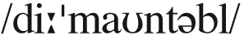
Words & Phrases
Words & Phrases
demountable a. able to be removed and put back 可拆卸的；可分离的
e.g.
They gave their performance on a demountable open stage.
他们在一个可拆卸的露天舞台上表演。
The demountable pavilion can be dismantled for transport and assembled again.
可拆卸展区可以拆除后运输然后重新组装。

Slide 44
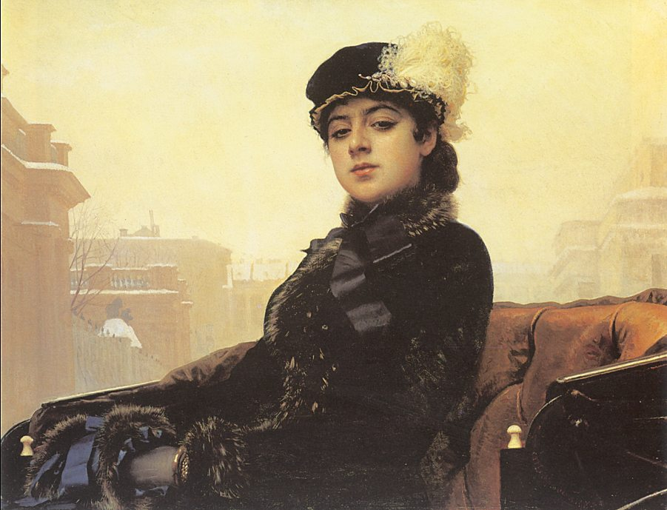
exhibit
Words & Phrases
n. an object that is a part of an exhibition
v. to put sth. interesting in a museum or other public places so that people can go and look at it
Work in pairs and make sentences using the pictures.
1. Unknown Woman; mystery
Unknown Woman
exhibited mystery.
Unknown Woman by Kramskoy

Slide 45


exhibit
Words & Phrases
2. archaeology majors; dinosaur exhibits
The archaeology majors studied the dinosaur exhibits at the museum.
3. the Metropolitan Museum; Goya’s works
The Metropolitan Museum is exhibiting Goya’s works this month.
The Third of May 1808

Slide 46

Words & Phrases
Words & Phrases
ostensibly ad. used for saying that although sb. pretends to have one reason for sth., there is in fact another reason 表面上；假装地
e.g.
She ripped off a leather jacket while ostensibly trying on clothes.
她装模作样试穿衣服时偷了一件皮夹克。
Ostensibly he is on a business trip, but he spends most of the time on the beach.
表面上他是因公外出，实际上大部分的时间都是在海边。
The party secretary resigned, ostensibly from ill health.
该党的书记辞职了，表面上是健康原因。
Word family: ostensible a.

Slide 47

Words & Phrases
Words & Phrases
extol vt. (fml) to praise sth. in a very enthusiastic way 赞美；颂扬
e.g.
The report extolled the virtues of Internet technology.
该报告大赞英特网科技的优点。
The general was extolled as the man who had led the country to victory.
这位将军被誉为领导全国赢得胜利的人。
The Indian software industry has achieved rapid development in recent years, extolled as “ the next software empire after us ” ( Bill Gates )

Slide 48
utility
Words & Phrases
n. (fml) the state of being useful
n. (plural) a public service such as gas, water, or electricity that is used by everyone
Work in pairs and translate the phrases.
1. bills for utilities
2. domestic utility
3. utility companies
水电及煤气的账单
家庭用品
公用事业公司
Word family: utilitarian n. & a.

Slide 49

Words & Phrases
Words & Phrases
salubrity n. [U] the quality of being favourable to health or well-being 有益健康；强身
e.g.
The salubrity of cold bath is not known to us all.
冷水浴有益于健康并不为我们所有人知晓。
Going for exercise often can improve one’s salubrity.
经常锻炼身体能够增进健康。
Word family: salubrious a.
Antonym: insalubrity 有碍健康，不健康

Slide 50
medieval
Words & Phrases
adj. relating to the period of European history between about the year 476 AD and the year AD 1500
Here are two medieval cases. Work in pairs and rewrite them.
1. In the Medieval times adults were forbidden four-footed flesh (meat) on Friday – only fish.
Only fish were available to adults as a source of protein on Friday in the medieval times, as four-footed flesh (meat) were forbidden to have.

Slide 51

medieval
Words & Phrases
2. Medieval Europe was far from unified; it was a large geographical region divided into smaller and culturally diverse political units.
A large geographical region divided into smaller and culturally diverse political units, Medieval Europe was far from unified.
Medieval Europe

Slide 52
gigantic
Words & Phrases
adj. extremely large
Work in pairs and make sentences using the phrases provided.
1. April 1; gigantic lie; housing prices
On April 1, she told a gigantic lie by saying the housing prices would drop dramatically that very day.
2. slum; a gigantic rubbish heap
The slum looked like a gigantic rubbish heap.

Slide 53
Words & Phrases
3. the allied forces; gigantic humanitarian operation
The allied forces have accomplished this gigantic humanitarian operation.
4. gigantic screens; light up
The gigantic screens behind her were lit up.
5. gigantic data centre; visitors
The gigantic data centre attracted visitors from abroad.

Slide 54

Words & Phrases
Words & Phrases
lark n. [C]
1. (infml) sth. that you do for fun or excitement 嬉戏；玩笑；玩乐
e.g.
They stole the car for a lark, but now they’re in trouble.
他们偷了汽车原以为好玩，现在可惹祸了。
2. a small brown bird that is common in Europe and is known for singing while it flies 白灵鸟；云雀
e.g.
The swallow flies high, the lark flies higher, the eagle flies highest.
燕子飞得高，云雀飞得更高，鹰飞得最高。

Slide 55
indignant
Words & Phrases
adj. angry because of an unfair situation or someone’s unfair behaviour
Work in pairs and find the collocations.
1. He was indignant over the way he was treated.
2. They remain indignant about the portrayal of their team.
3. He is indignant at her words.
4. Hearing this, the team members began to feel indignant with James and John.

Slide 56

Words & Phrases
Words & Phrases
relent vi. to change your mind about not allowing sth. to happen or not letting sb. do sth. 发慈悲；变宽容
e.g.
At first she threatened to dismiss us all, but later she relented.
起初她威胁要解雇我们所有的人，但是后来她态度软了下来。
The police will not relent in their fight against crime.
警方在跟犯罪分子的斗争中决不手软。

Slide 57

Words & Phrases
Words & Phrases
exalt vt. (fml)
1. to praise sb. or sth. very much 颂扬；赞扬
e.g. Don’t exalt him to the skies.
别把他捧上天了。
His work exalts all those virtues that we, as Americans, are taught to hold dear.
他的作品颂扬了所有那些身为美国人应该珍视的美德。
2. if sb. is exalted to a more important position or status, it is given to them 提升；提拔
e.g. He was exalted to the position of general manager.
他被提升到总经理的职位。

Slide 58
initiator
Words & Phrases
n. person who makes sth. start
(v. initiate n. & adj. initial )
Work in pairs and complete the sentences.
1. He was the ___________ of the project.
2. The company ___________ a management training programme for small businesses.
3. However, once you have agreed to the ___________ request, they would begin to ask for more.
initiator
initiated
initial

Slide 59

Words & Phrases
Words & Phrases
dismember vt. to take away important parts of a country, organization, or system so that it can no longer continue to exist or be successful 瓜分；肢解
e.g.
It is easy to see why investors are eager to dismember the big banks.
我们很容易理解投资者为何希望分拆大银行。
Foreign intelligence agencies are also sponsoring these horrendous attacks to create instability in Pakistan to dismember and denuclearize it.

Slide 60
vow
Words & Phrases
v. fml to promise that you will do sth.
n. a serious promise
Work in pairs and find regularity in the sentences
1. They vowed to use a scientific approach.
2. The rescue team vowed to save as many earthquake victims as they could.
vow to do sth.

Slide 61

vow
Words & Phrases
Read aloud the wedding vows.
I xxx, take you xxx, to be my wedded wife / husband. To have and to hold, from this day forward, for better, for worse, for richer, for poorer, in sickness or in health, to love and to cherish till death do us part. And hereto I pledge you my faithfulness.

Slide 62

Words & Phrases
Words & Phrases
dynamite
1. vt. to destroy sth. using a powerful explosive（用炸药）炸毁
e.g.
They will dynamite and burn our museums and try to steal our valuable artwork.
他们打算炸毁、烧毁我们的博物馆，并企图偷窃我们宝贵的艺 术品。
2. n. [U] a substance used for causing explosions, esp. for breaking rock into pieces 炸药
e.g. The soldiers blew up the bridge with dynamite.
士兵们用炸药炸毁了这座桥。

Slide 63

opponent n.
Words & Phrases
1. Why did the Cuban player kick the referee in the face during his taekwondo bronze medal match in Beijing?
Because he felt so mad after being hit by ____________________.
2. What was the consequence of doing so?
He would face a life ban.
n. someone who is competing against you
Work in pairs and complete the sentences.
his opponent

Slide 64

Words & Phrases
Words & Phrases
inconceivable a. impossible to think about or imagine 无法想象的；不可思议的
e.g.
It once seemed inconceivable to everyone that men should travel to the moon.
人们一度认为人类飞上月球似乎是不可想象的。
A marriage without conflict is almost as inconceivable as a nation without crisis.
没有冲突的婚姻和没有危机的国家一样，几乎无法想象
Antonym: conceivable
Word family: conceive v.

Slide 65


transcend
Words & Phrases
v. (fml) to become free of negative attitudes, thoughts, or feelings that limit what you can achieve
Shakespeare
Work in pairs and make sentences, using the images.
Reference:
1. Shakespeare can transcend time.
2. Mickey Mouse has transcended age.

Slide 66
transcend
Words & Phrases
Work in pairs and translate the sentences.
However, wisdom encourages us to stretch beyond and transcend our limitations.
但是智慧却鼓励我们跨出并超越我们自身的局限性。
So Mr. Obama held a news conference, to make his case that overhauling the country's health insurance system is an issue that should transcend politics.
为此，奥巴马举行了新闻发布会，向全国人民说明，改进美国的医疗保险制度是一个应该超越政治的问题。

Slide 67
Words & Phrases
Words & Phrases
leave aside: to not consider sth. because you want to consider sth. else instead 不考虑（某事物）
e.g.
We’ll leave aside the problem of agency until next week.
我们暂时把代理权问题搁置在下周考虑。
Let’s leave the matter aside for a moment.
我们把这件事搁一会儿再说。
Leaving aside the financial implications, do you really believe your proposal will solve our problem?
且不说经费问题，你真的认为你的提议能解决我们的问题吗？

Slide 68
Words & Phrases
Words & Phrases
so much the better used for saying that if sth. is true or possible, it will be even nicer 甚至更好
e.g.
The result is not very important to us, but if we do win, (then) so much the better.
输赢对我们并不十分重要, 但假如我们真赢了,（那）就更好了。
If you can cope with a harder class, so much the better for you.
如果你能妥善对付一个比较难弄的班级，那对你就更好了。
They usually cost about $50, but if you can get one for less, then so much the better.
它们通常的价格是50美元左右，但如果你能便宜些买下来就更好了。

Slide 69
so much the better
Words & Phrases
Work in pairs and find the patterns of the usage.
1. If I can use the chopsticks, so much the better.
2. If you have two single rooms, so much the better.
3. If he will come, so much the better.
If clause + so much the better

Slide 70
get hell
Words & Phrases
(also catch hell) be blamed or abused 挨骂
e.g.
He'll get hell from his mother for getting so late again.
他又起得那么迟，肯定要挨他妈妈一顿臭骂。
If dad finds out that you were using his credit card, you’re gonna catch hell.
如果父亲发现你使用过他的信用卡，你就会受到责备。

Slide 71
Words & Phrases
Words & Phrases
love at first sight: the experience of falling in love with sb. as soon as you see them for the first time 一见钟情
e.g.
The only true love is love at first sight; second sight dispels it .
真爱在于第一眼，第二眼就看不上眼了。
In a city as cynical as New York, is it still possible to believe in love at first sight?
在纽约这个愤世嫉俗的城市，一见钟情是否仍然可信呢？

Slide 72
love at first sight
Words & Phrases
Work in pairs. Find the implication in the sentence and complete it.
We just understood each other completely. My family is her family. It wasn’t love at first sight; it was family at first sight.
This sentence implies that in addition to love at first sight, ________________________ is equally important in marital issues.
family background

Slide 73
Useful Expressions
1.结构创新
1. structural creativity
2.最大跨度
2. the longest span
3.博爱的象征物
3. a symbol of brotherhood
4.提升房地产价格
4. increase real estate values
5.军事瞭望塔
5. a military lookout
6.防御塔
6. defense tower
7.传统美学捍卫者
7. the defenders of traditional beauty
8.振振有词、义愤
填膺的抗议信
8. a sounding letter of
indignant protest
9.颓废阶层
9. effete class
10.一见钟情
10. love at first sight

Slide 74
Useful Expressions
11.蜂拥而至竟相参观
11. flock to visit
12.具有了新的意义
12. acquire new meanings
13.钢架工艺
13. filigree of steel
14.旅游者心中的圣地
14. the Mecca of travellers
15.不断扩大的重要性
15. widening significance
16.破碎视觉意象的先导者
16. the initiator of the dismembered visual image
17.法国抵抗组织的战士
17. the Resistance fighters
18.纳粹的黑豹装甲师
18. the Nazi panzer
19.用炸药把它炸毁
19. dynamite it
20.右翼军事对手
20. right-wing military opponents

